Slide 1
SMALL PONDS: PANACEA TO MULTIPLE DISASTER PROBLEMS
PRESENTED BY
JIBA RAJ POKHAREL
SUPPORTED BY
ROTARY CLUB, NEPAL
NEPAL ACADEMY OF SCIENCE AND TECHNOLOGY
NEPAL CENTER FOR DISASTER MANAGEMENT
DP NET, NEPAL
COMMUNITY ADVOCACY AND DEVELOPMENT FORUM
FOREST CONSUMER GROUP, BAHUNIJHORA

Slide 2
FLOOD PREVENTION IN ANCIENT TIMES
Chanakya in the fourth century BC suggested for the construction of ponds
To prevent flood
For water harvesting
;xf]bsdfxfof{]bs+ jf ;]t' aGwo]t\ . cGo]iff+ jf aWgtf+ e"lddfu{j[Iff]ks/0ffg'u|x+ s'of{t\ .
One can see ponds in the cities of Kathmandu Valley
In Terai, also several ponds can be observed

Slide 3
PONDS IN NEPAL
Ponds in Thimi ( Source: Google)
Ponds in Janakpur ( Source: Google)

Slide 4
FLOOD RESISTANT DESIGN
Buddha
Dharma
Sangha
Levee
Channel

Slide 5
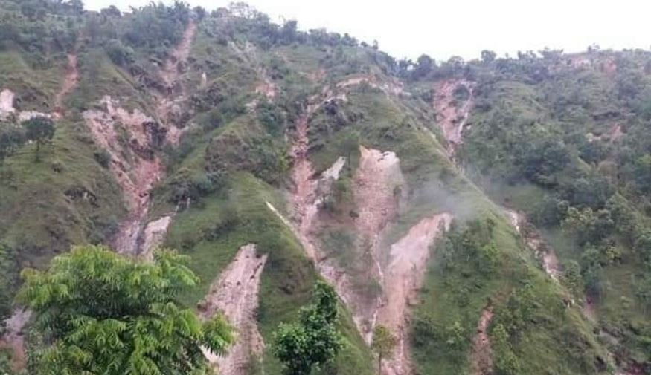
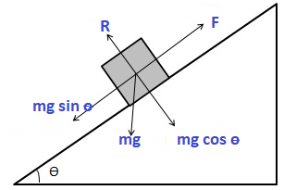
LANDSLIDES

Slide 6
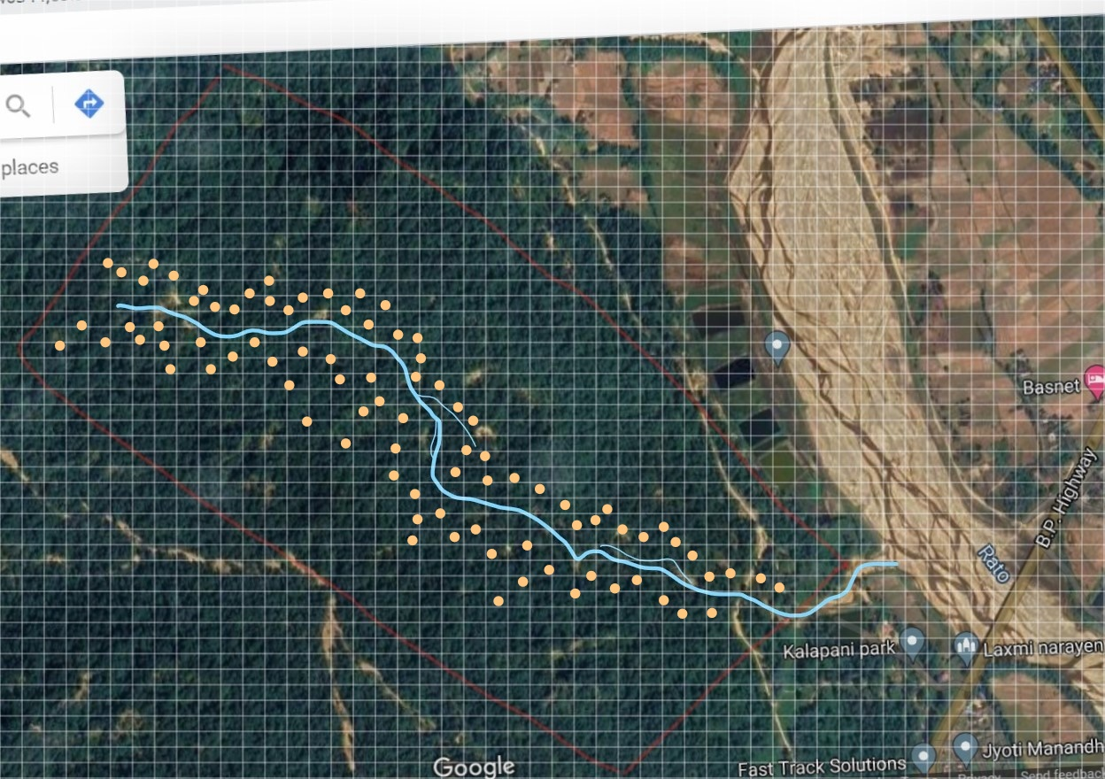
SITE AND PONDS PROPOSED LOCATION

Slide 7
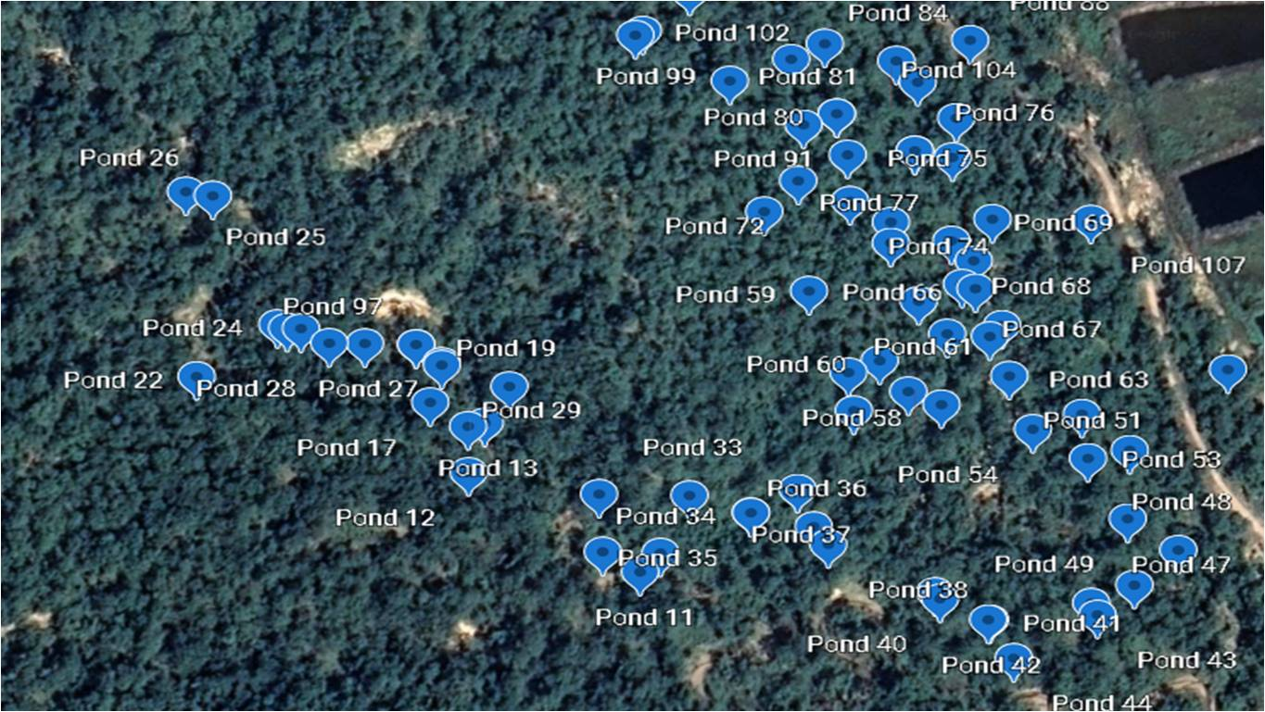
PONDS ACTUAL CONSTRUCTED

Slide 8
PONDS
Pond size has been determined based on
That which can be completed in a day by four persons
Can be easily constructed in the hilly areas
The side slope is 1.5:1. It will be increased to 2:1 in the next site
The excavated soil is exactly the same as required for the embankment in three sides
A 4” pipe put for overflow
Area is 576 sq ft, 55 sq meter
Volume is 1330 cft, 37.5 cu meter
It is 8ft x 8ft at the bottom and 24 ft x 24 ft at the top
The embankment is of the slope of 1:1

Slide 9
PONDS
Construction
The pond is laid out first
The green turf is taken out
It is then dug for a depth of 4ft
The embankment is put at the three sides
It has a slope of 1:1 outside, 1.5;1 inside and it is 2 ft high and 2 ft wide at the center
The total depth is 6 ft
The overflow pipe is put at 5’ level
The green turf is put back

Slide 10
PONDS

Slide 11
PONDS

Slide 12
PONDS

Slide 13
PONDS

Slide 14
PONDS

Slide 15
RAINFALL IN NEPAL Panch Khal area( Av 1226, Max1418, Min 1055)
Winter (3%), Pre monsoon(14%)
Typical large event
(a) rainfall amount: ~35 mm;
(b) duration: ~4 h;
(c)average intensity:
from ~13 mm h-1 (10-min maximum intensities ~60 mm h-1,
30-min intensities ~38 mm h-1 and
60-min intensities ~26 mm h-1);
(d) ~10–50% of rain falls in the first quarter of the event,
50–80% in the first half, and
75–90% in the first three quarters of the event.
Monsoon (78%), Post (5%)
Typical large event
(a) rainfall amount: ~40 mm;
(b) duration: ~8 h;
© average intensity:
from ~6 mm h-1 (10-min maximum intensities ~36 mm h-1,
30-min intensities ~24 mm h-1 and
60-min intensities ~18 mm h-1);
(d) ~10–35% of rain falls in the first quarter of the event, 60–70% in the first half, and 80–90% in the first three quarters of the event.

Slide 16
ROLE OF THE PONDS FOR TYPICAL LARGE EVENTS
PRE MONSOON: 4 HOURS, 35mm
9 mm/hr
Leaving 50 per cent of it will be 4.5
In a pond for every 2000 sq m
4.5 /1000 x 2000 = 9 cu m
It will hold for 4 hours
Monsoon: 8 HOURS, 40mm
5mm/hr
Leaving 50 per cent, it will be 2.5 mm
In a pond for every2000sq m
2.5/1000 x 2000 = 5 cu m
It will hold for 8 hours

Slide 17
ROLE OF THE PONDS FOR 100 YEARS RETURN PERIOD
TOTAL RAINFALL= 300 mm IN 24 HOUR
12.5 mm/hr
Leaving 50 per cent of it will be 6.25
In a pond for every 500 sq m
6.25 /1000 x 500 =3.1cu m
It will hold for 12 hours
IN 12 HOURS TIME, THE LEAKAGE OF THE POND WILL BE 144 Cm which is about the height of pond at 2mm per minute
The rainfall has been confined to 150 mm
Ranjan Dahal in his article Rainfall threshold and landslide has outlined that 144 mm rain for 24 hours is the threshold for landslides

Slide 18
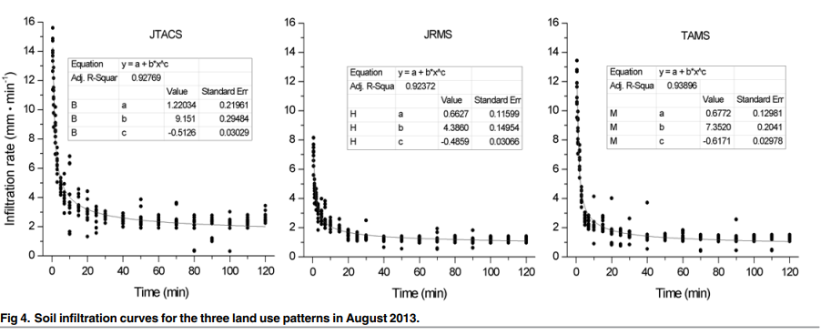
INFILTRATION RATE

Slide 19
FLOOD REDUCTION
HALF OF RAINFALL HAS BEEN CONTAINED BY PONDS
THERE IS THUS A FLOOD REDUCTION
Extracted from Journal Science of the Total Environment
Article entitled Farm ponds in southern China: Challenges and solutions for conserving a neglected wetland ecosystem

Slide 20
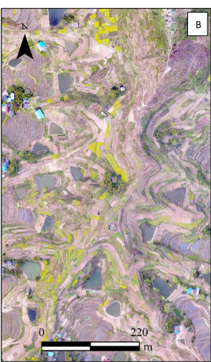
SEDIMENTS REDUCTION
HALF OF RAINFALL HAS BEEN CONTAINED BY PONDS
THERE IS THUS A SEDIMENTS REDUCTION
Extracted from Journal Science of the Total Environment
Article entitled Functions of traditional ponds in altering sediment budgets in the hilly area of the Three Gorges Reservoir, China

Slide 21
SLIP SURFACE AND WATER LEAKAGE
It has been found that the water leakage does not go further than 2.9 meter
The Slip surface is far below than 2.9 meter
Water of the pond does not get to go to the slip surface
Extracted from Journal Scientific Reports from article entitled Estimating Method of Maximum Infltration Depth and Soil Water Supply

Slide 22
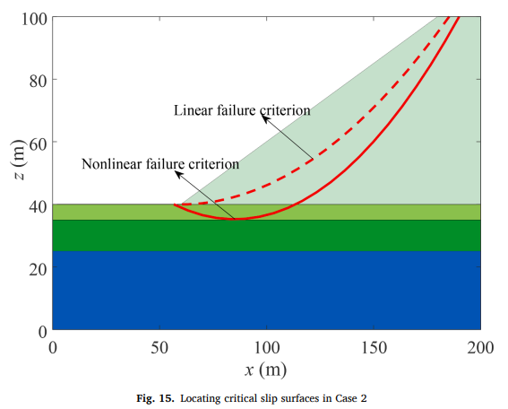
SLIP SURFACE AND WATER LEAKAGE
Extracted from Journal Advances in Engineering Software from article entitled An improved whale optimization algorithm for locating critical slip surface of slopes

Slide 23
WILD FIRE AND POLLUTION RISK REDUCTION
Dr. Ajaya Lal has found that there is lesser humidity and temperature in the neighborhood of ponds in Janakpur
Extracted from Journal Buildings
Article entitled Diurnal Thermal Behavior of Pavements, Vegetation, and Water Pond in a Hot-Humid City

Slide 24
LESS POSSIBILITY OF WILD ANIMAL ATTACK
Ponds provide water for animals to drink.
They also produce fodder in considerable amount.
In such cases, animals do not enter into human settlements
Extracted from Journal Plos One
Article entitled Human-Wildlife Conflicts in Nepal: Patterns of Human Fatalities and Injuries Caused by Large Mammals

Slide 25
WATER RETENTION IN PONDS
PONDS RETAIN CONSIDERABLE AMOUNT OF WATER
Extracted from Journal Science of the Total Environment
Article entitled Assessment of the ecosystem services provided by ponds in hilly areas

Slide 26
LESS POSSIBILITY OF LIGHTNING
Lightning falls on moist areas more than dry areas
It is likely to fall on forests with ponds which are moist due to the ponds
Extracted from Journal Atmospheric Chemistry and Physics
Article entitled The climate impact of aerosols on the lightning flash rate: is it detectable from long-term measurements

Slide 27
SUSTAINABILITY OF PONDS
PONDS HAVE TO BE DREDGED EVERY YEAR FOR TAKING OUT THE COLLECTED SEDIMENTS
OTHERWISE ITS WATER HOLDING CAPACITY WILL REDUCE
THE SEDIMENTS CAN BE A GOOD FERTILIZER
IT CAN BE SOLD AND SPENT FOR MAINTENANCE OF PONDS
ONE POND EMPLOYS 4 PERSONS FOR 4 ROPANIS
IN PADDY PLANTATION 5 PERSONS ARE REQUIRED FOR ONE ROPANI
IT IS THUS WELL WITHIN THE REACH OF COMMON PEOPLE

Slide 28
NEXT PROGRAM IN KHOTANG,KHARPA
A 720 MW DUDH KOSHI HYDROPOWER PROJECT IS BEING BUILT
THERE ARE RIVULETS JOINING RAWA KHOLA WHICH JOINS DUDH KOSHI
IN KHARPA, 100 PONDS ARE BEING DUG STARTING FROM NEXT WEEK END

Slide 29
USE OF COST EFFECTIVE INDIGENOUS TECHNOLOGIES
INDIGENOUS TECHNOLOGY
Bhal Katne
Chhapari Purne
BOTH THESE TECHNOLOGIES HAVE BEEN APPLIED

Slide 30
USE OF COST EFFECTIVE INDIGENOUS TECHNOLOGIES

Slide 31
References
Aryal Suman, 2012, Rainfall and Water Requirement of Rice during growing period, The Journal of Agriculture and Environment, Volume 13
Bin Fu et al,2018, Assessment of the ecosystem services provided by ponds in hilly areas, Science of the Total Environment, 642(2018)979-987
Chundi Chen et al, 2016, Incorporating landscape connectivity into household pond configuration in a hilly agricultural landscape, International Consortium of Landscape and Ecological Engineering and Springer Japan
D Scott Munro et al, 1997, Rainfall, evaporation and runoff responses to hillslope aspect in the Shenchong Basin, Catena, 29(1997), 131-144
Gautam Tilak, 2013, Soil Characteristic in moist tropical district of Sunsari, Nepal Journal of Science and Technology
Gert Verstraeten et al, 2000, Estimating trap efficiency of small reservoirs and ponds: methods and implications for the assessment of sediment yield, Progress in Physical Geography 24,2 (2000) pp. 219–251
Kumar Monoj et al, 2015, Environmental Perspectives of Pond Ecosystems: Global Issues, Services and Indian Scenarios, Current World Environment, Vol 10(3), 848-867
Mingquaun Lu et al, 2019, Functions of traditional ponds in altering sediment budgets in the hilly area of the Three Gorges Reservoir, China, Science of the Total Environment, 658(2019)536-548
Sharma Til Prasad Pangali et al, 2019, Review of Flood Disaster Studies in Nepal, International Journal of Disaster Risk Reduction, 34(2019), 18-27
Tomasweski et al, 2005, The impact of cooling ponds in north central Texas on Dairy Farm Performance, Journal of Dairy Science, Volume 88, Issue 6, p 2281-2286
Wei et al, 2007, The effect of land uses and rainfall regimes on runoff and soil erosion in the semi-arid loess hilly area, China, Journal of Hydrology, Elsivier
Wenjun Chenet al, 2019, Farm ponds in southern China: Challenges and solutions for conserving a neglected wetland ecosystem, Science of the Total Environment, 659(2019) 1322-1334

Slide 32
THANKS to Raghav Paudel, Tabassum Siddiqui, Inu Shalike and Deepak Paudel ANY QUERIES PLEASE

